Slide 1
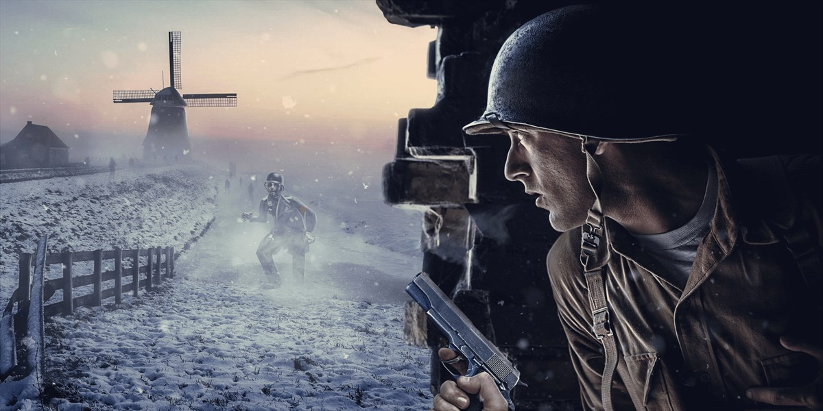

Slide 2
It’s only my second game so please don’t be harsh ☺ !
Also this a work in progress , the are still many mechanics yet to be added . Let’s get into it !

Slide 3
My idea for this game was to recreate a game from my childhood while adapting it to fit with the modern era mechanics .
The game that inspired me is still one of my favorites , Call of Duty World at War Zombies .

Slide 4
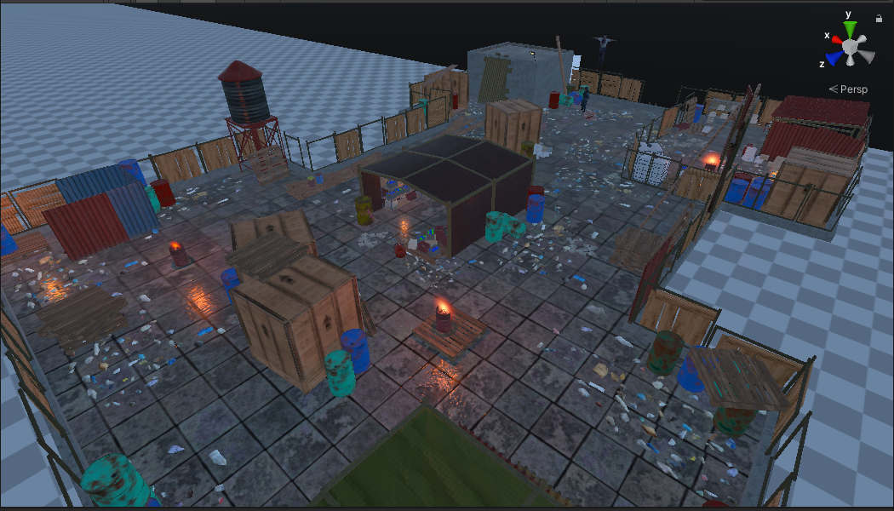
I chose the setting of the action to be appropriate for the game so I went with a rooftop map that has a apocalyptic vibe to it .

Slide 5
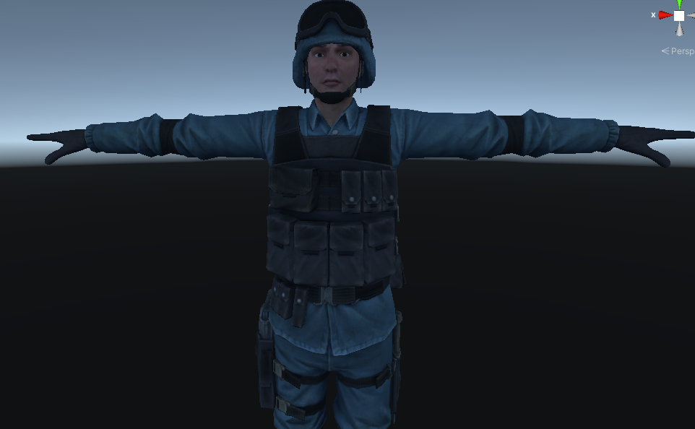
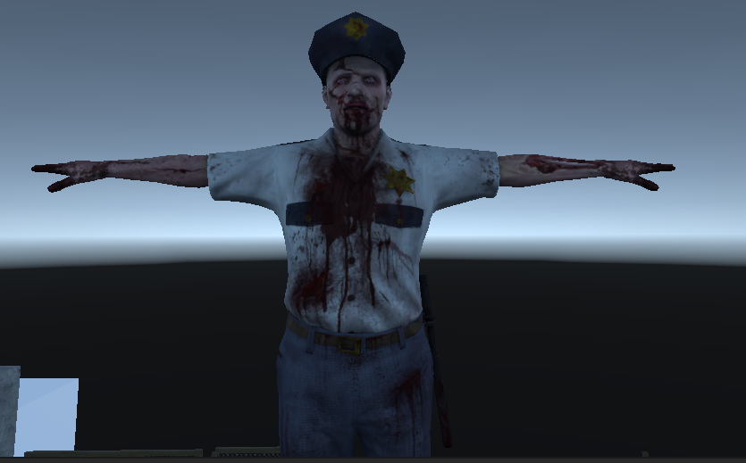
I first began by adding the main characters , the player and the zombie(Derrick) .

Slide 6
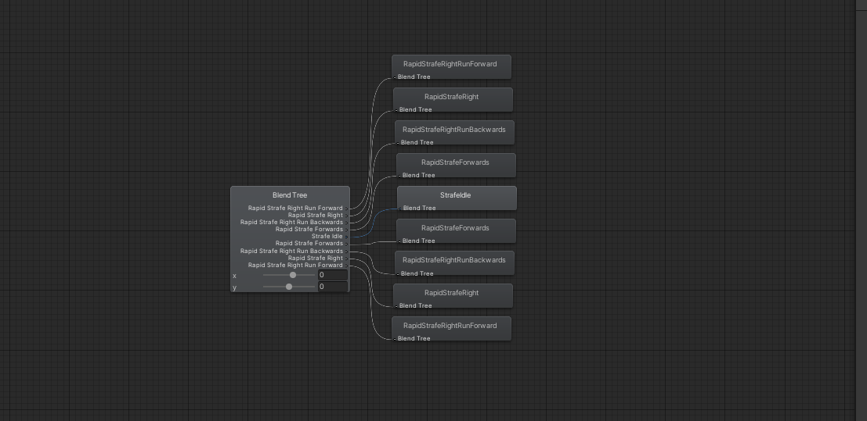
I first began by adding an animator and added all the movement animations required . The animations will be handles using a blend tree which blends them all together .

Slide 7
The animations are played using 2 parameters x and y which are blended together by the blend tree .
Once I had all that set up we need to move our character so I added a movement script I called character locomotion .

Slide 8
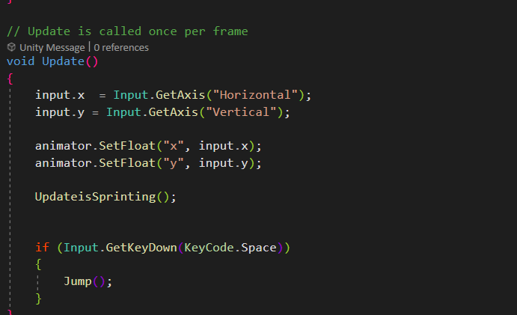
This bit of code is responsible for moving the player on the world axis and changing the animation parameters so each animation blends in nicely with the other ones .

Slide 9
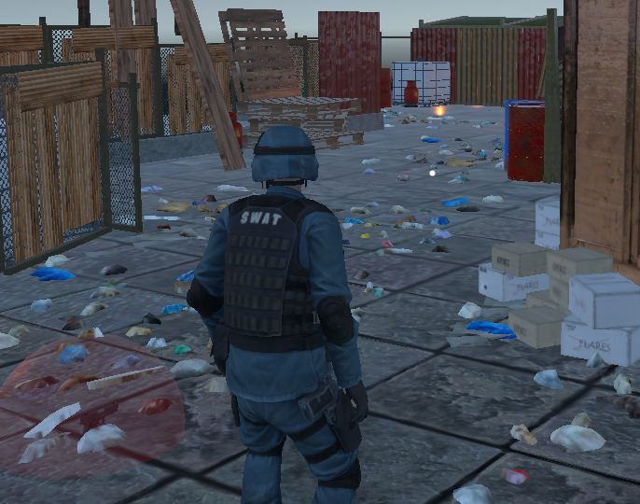
Now that we have our character moving it’s time we advance .
I downloaded the Cinemachine package and next set up my third person camera . I chose it to follow the player .

Slide 10
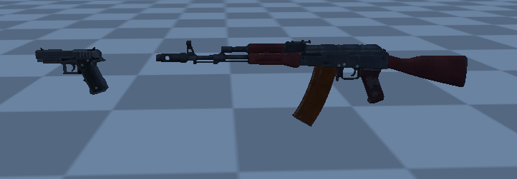
Once all the basics mechanics are set up and working well together we need to get to the fun stuff and by that I mean adding guns .
Right now the weapons are split in 2 categories: Primary and Secondary
but I will get to that later .

Slide 11
The next part will be attaching the guns to the player model . This is achieved by using animation rigging and rig constraints.
The way rigs work is hard to explain so to make it short let’s say once I touch the weapon , using a script for picking up the weapon , the weapon’s transform (coordinates) will become a child of the character’s hand so whenever the player moves the gun moves with him .
The rigs are separated into layers so we use a rig layer for a separate action . One layer is used for aiming the gun , another is used for controlling the torso of the character and the last one is used for putting the guns on the back of the character .

Slide 12
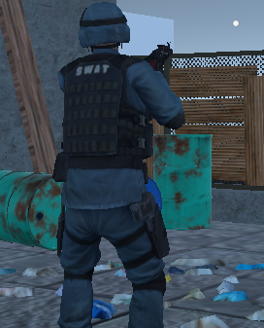
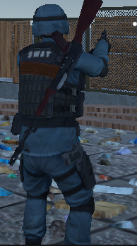
We first have the character holding the rifle and then it can holster it and pull out the pistol and vice versa .

Slide 13
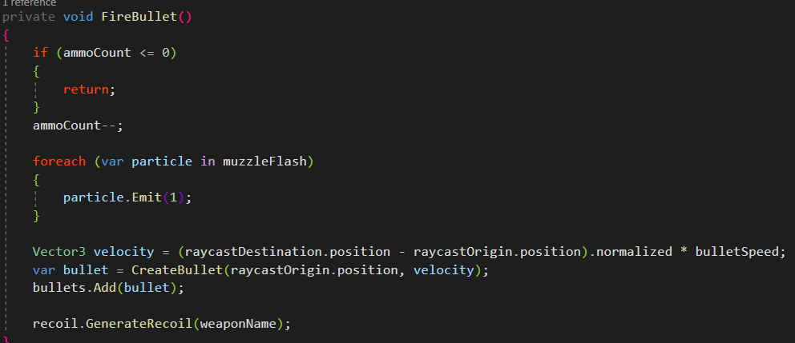
The next step is creating a script for the gun . Each time the player presses the mouse button an invisible ray will be cast from the gun and a imaginary bullet will be created and “fired” using the function FireBullet() . Also the weapon cannot fire if there are is no ammo in the magazine . The rest of the code handles the muzzleflash and the recoil. Also the weapon has a zoom in function so when the player presses left mouse the camera will zoom .

Slide 14
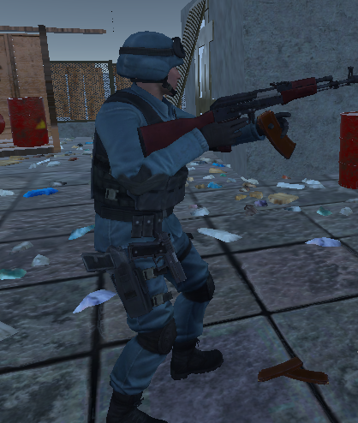
To make the gun more realistic I added some bullet tracers and weapon recoil .
The way recoil works is using a mathematical function . Each time a bullet is fired , the gun together with the camera will move slightly to the next point . The direction in which the gun moves are set up using X and Y axis and points .
Next up we have the weapon reloading . Once the clip is empty the character automatically changes the empty clip with a new one . Also the old clip drops to the ground and remains in the game worlds . This is achieved using animation events .

Slide 15
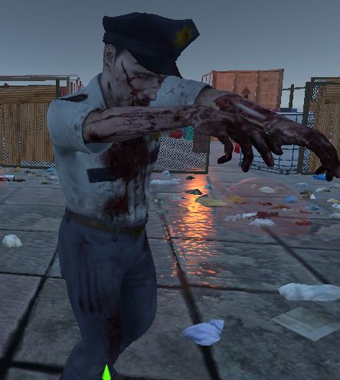
The last part will be making our friend Derrick seem more alive or in Derrick’s case more dead let’s say . I downloaded a zombie animation that fits him perfectly .

Slide 16
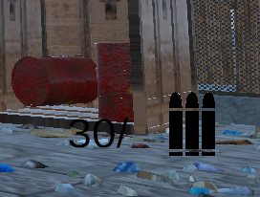
Derrick will follow the player anywhere he goes or at least he’ll try to.
To make things more fun I added a health system and some ragdoll physics so whenever Derrick will take enough damage to kill him the ragdoll physics will be activated and his basic animations will be disabled and he will go flying across the map . Literally !
One last touch I added in order to make things more immersive is an UI component that tells the player how many bullets he has in the magazine .

Slide 17

The end !

